Slide 1

GARMENT WORKER PRODUCTIVITY ANALYSIS
DISCOVERING PATTERNS AND TRENDS
PRESENTER: LAKSHMI MOUNIKA B

Slide 2

INTRODUCTION
OBJECTIVE: Explore various factors that significantly influence garment worker’s productivity. Uncover patterns and relationships that provide valuable insights into the dynamics of the industry.
PURPOSE OF ANALYSIS: To gain a comprehensive understanding of the key determinants affecting the productivity of garment workers. By exploring factors such as idle time, idle men, overtime, and incentives, we aim to identify their impact on the actual productivity levels of the workforce.

Slide 3
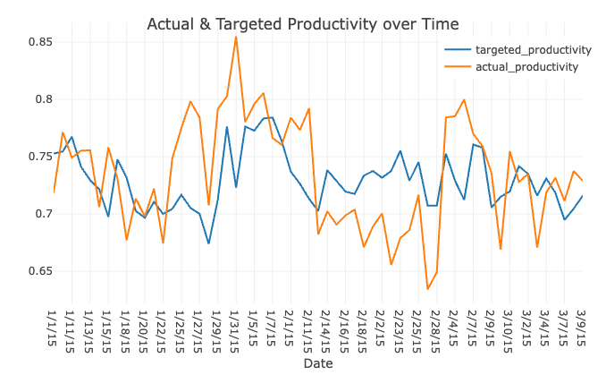
ACTUAL VS TARGETED PRODUCTIVITY OVER TIME

Slide 4
RESEARCH QUESTIONS
QUESTION 1: How does overtime and incentive distribution influence actual productivity in the garment industry? Are there optimal levels for maximizing efficiency?
QUESTION 2: How does the amount of idle time and idle men affect overall productivity? Are there opportunities to reduce idle time for improved efficiency?

Slide 5
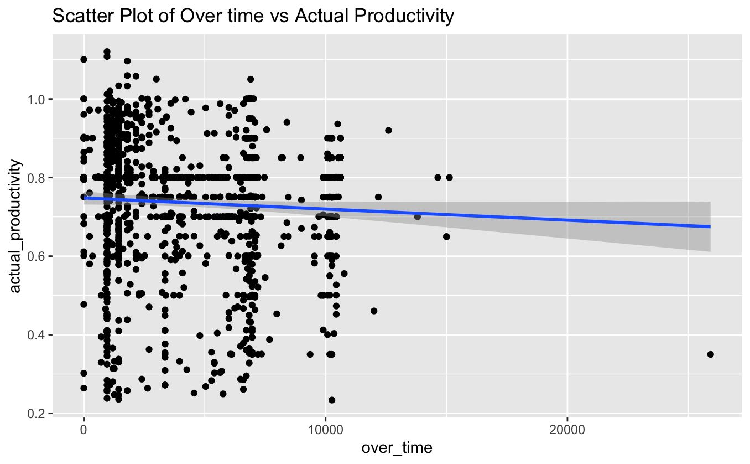
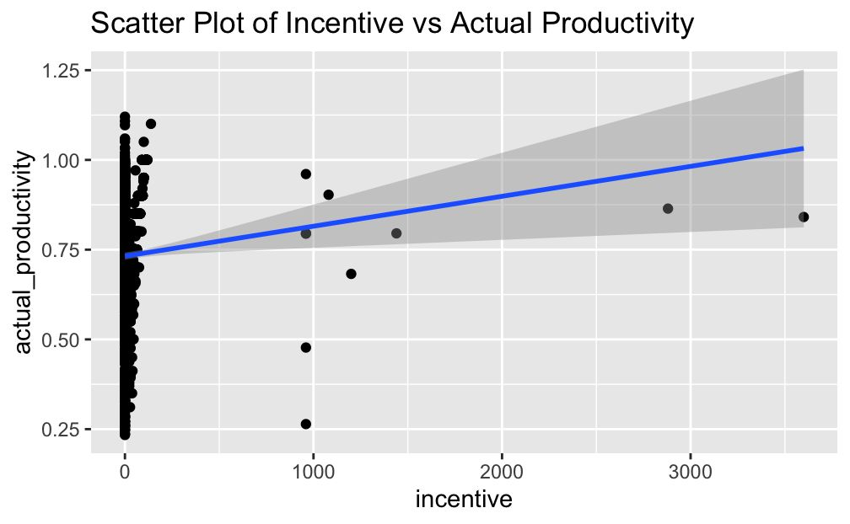
IMPACT OF OVERTIME AND INCENTIVE

Slide 6
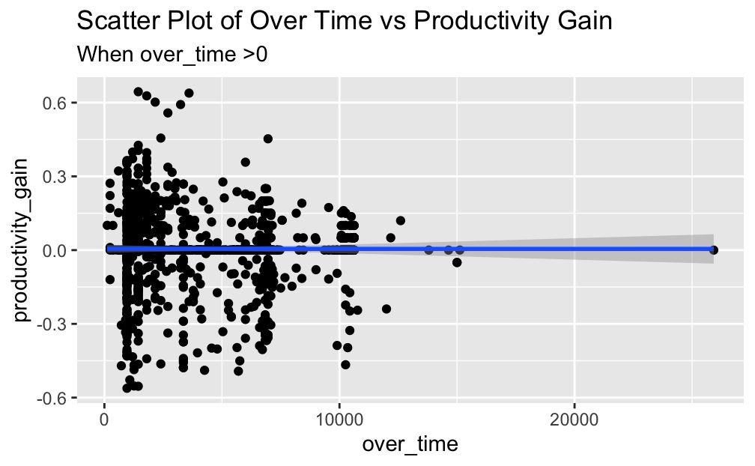
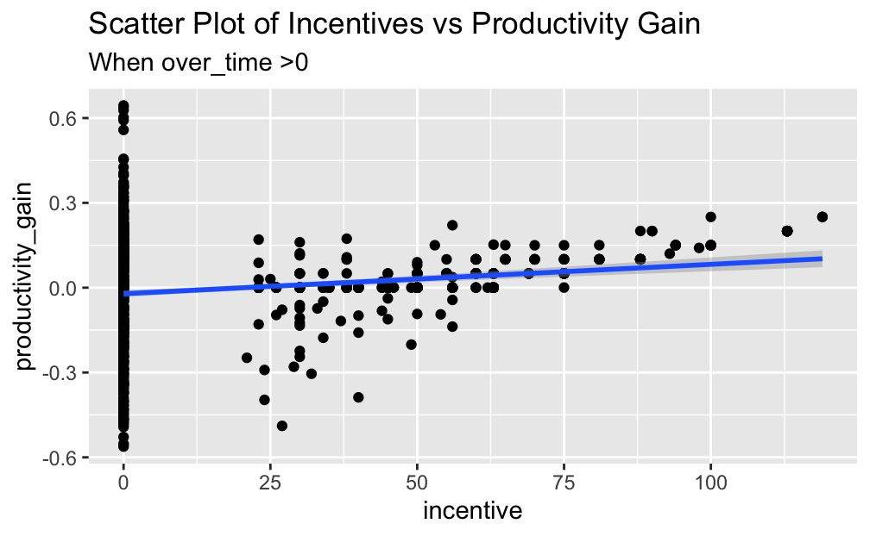
OPTIMUM CONDITIONS FOR EFFICIENCY
SWEET SPOT OF OVERTIME IS AROUND 5000-7000 HOURS PER QUARTER.

Slide 7
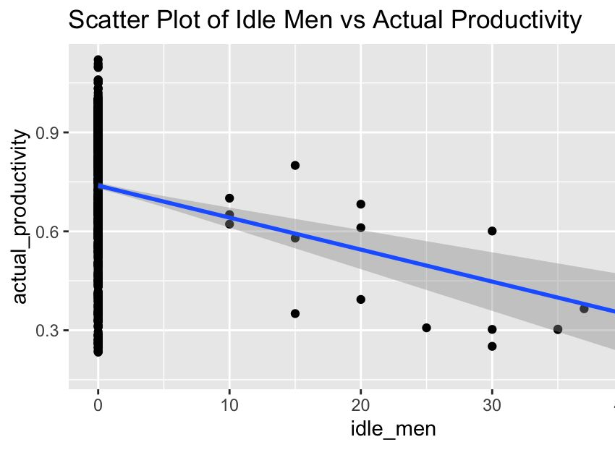
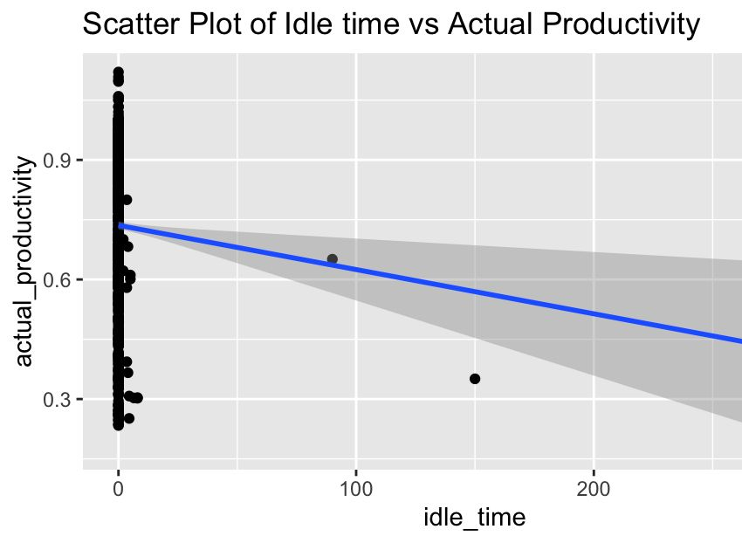
IMPACT OF IDLE TIME AND IDLE MEN

Slide 8
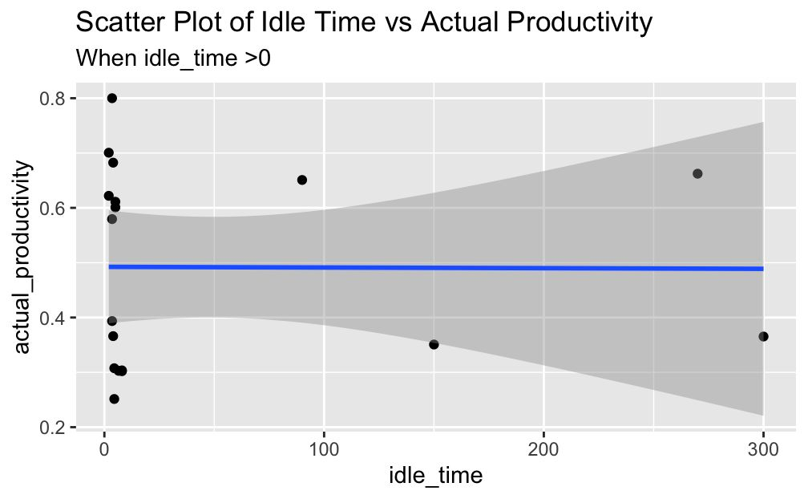
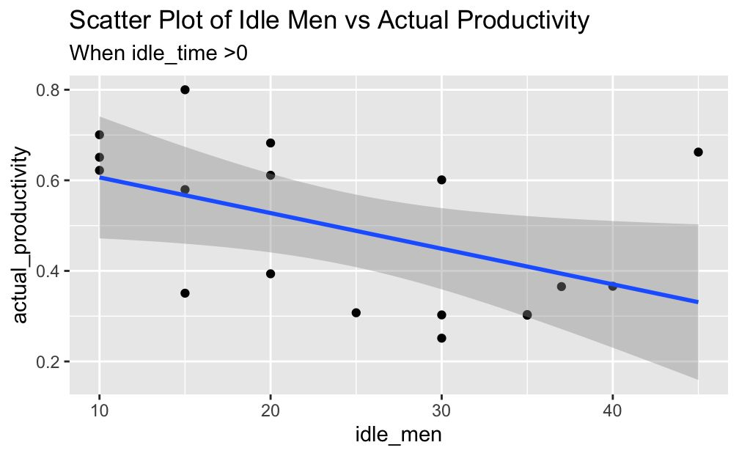
POTENTIAL PRODUCTIVITY GAIN
IF IDLE_TIME WAS REDUCED TO ZERO. THERE WOULD HAVE BEEN A 19% BOOST IN THE PRODUCTIVITY.

Slide 9

SUGGESTIONS
Overtime:
Implement overtime limits between 5000-7000 hours per quarter to balance motivation and fatigue
Schedule overtime during periods of high demand and adequately staff during regular hours
Provide ergonomic equipment and frequent breaks to mitigate exhaustion
Incentives:
Expand monetary incentive programs up to 98 points to maximize productivity
Set clear metrics aligning bonus payouts to throughput and efficiency
Consider non-cash rewards alongside financial incentives
Idle Time:
Re-engineer processes and resources to minimize workflow disruptions
Cross-train employees to enable flexible redeployment when bottlenecks arise
Improve visibility through digital dashboards on current utilization and capacity
Idle Men:
Right size staffing levels to closely match demand forecasts and workload
Realign unused manpower to support other departments or facilities
Provide training to expand skill sets utilizing idle bandwidth

Slide 10

QUESTIONS?

Slide 11
THANK YOU

